Slide 1

How to Build Your Team –
Section Bonding
with a Sense of Unity

Slide 2
Objectives:
Clarify the role between the Section Leader and the Director, as well as the role between the Section Leader and her singers
Team Building begins with Trust and Mutual Respect. We’ll review the components of these two important pillars of Team Building.
The section needs a positive, safe environment to flourish and grow. Here’s how the section leader can nourish this type of environment for singing and learning.
Identify what responsibilities can/ should be delegated to your team members.

Slide 3


Slide 4

This Photo by Unknown Author is licensed under CC BY-SA-NC

Slide 5
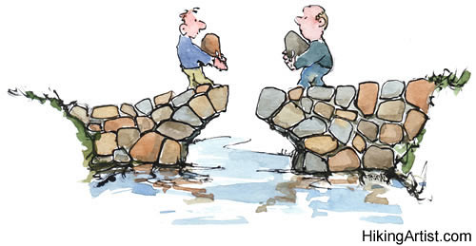
This Photo by Unknown Author is licensed under CC BY-ND

Slide 6
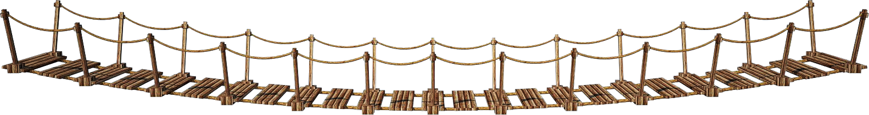
This Photo by Unknown Author is licensed under CC BY-NC

Slide 7


Slide 8
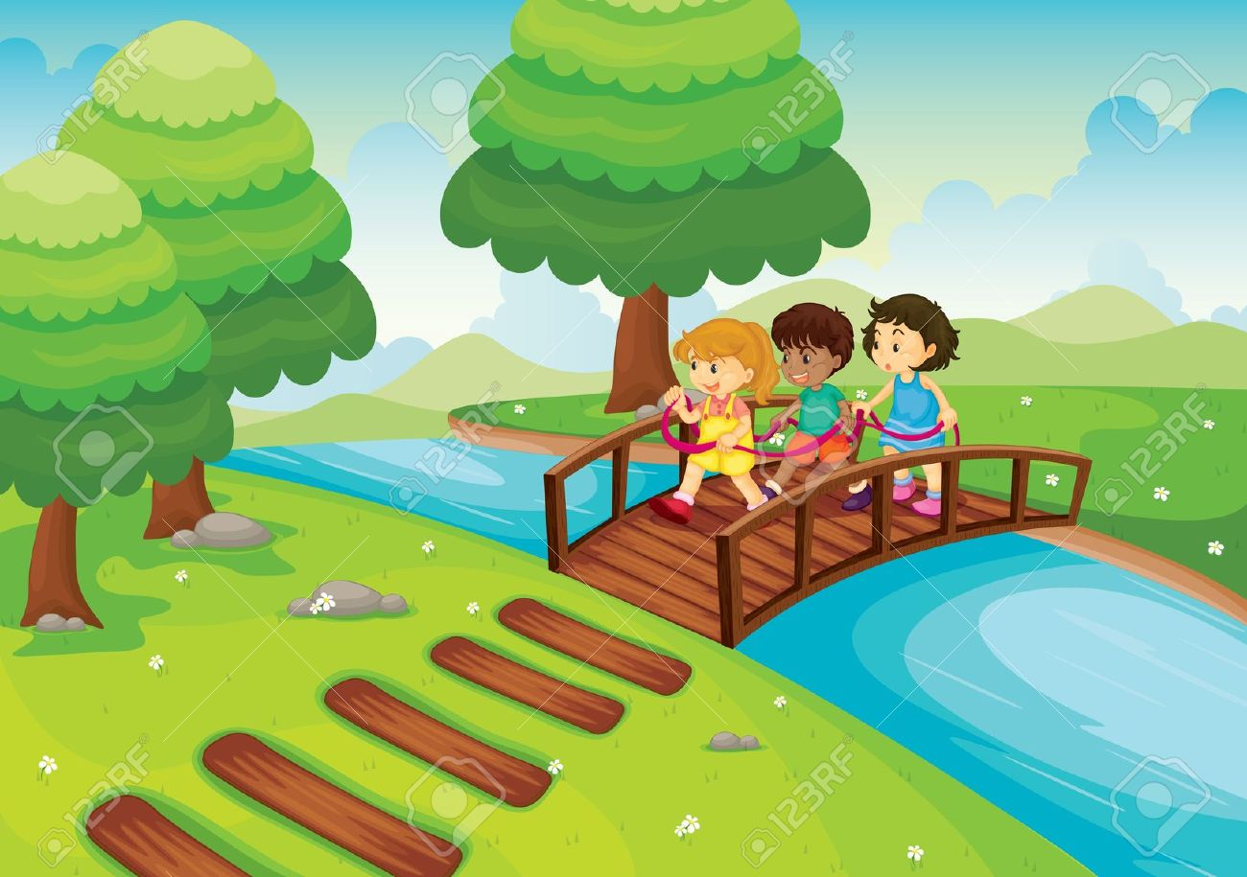
This Photo by Unknown Author is licensed under CC BY-SA-NC

Slide 9


Slide 10

POLL –
How many in your section,
including YOU?

Slide 11


Slide 12


Slide 13
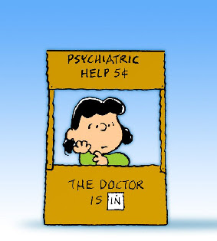
This Photo by Unknown Author is licensed under CC BY-NC-ND

Slide 14


Slide 15
Sample Agreement between Section Leader and her Section:
Leadership and singers are prepared and will follow through.
All will be inclusive, respectful, focused so our time together is fun and productive.
It’s ok for anyone/ everyone to make a mistake – we understand this is part of the learning process.
We share a desire to improve, grow and strengthen our individual performance skills.
We know and understand that everyone is on an escalator of improvement – everyone is getting better even if we are at different places on that escalator.

Slide 16
Everyone is encouraged to sing with their full performance voice and energy.
We all know the voice we should emulate (model) and we will allow singers time to experiment and try.
We encourage participation – volunteer without judgment of others.
We will attend outside sectionals and have at least one PVI a year, using that feedback in our weekly rehearsals.
We are education focused.
We encourage recording weekly – sharing our recording with others in the section, while also doing a self- assessment.
During coaching we will take our own notes, share that information, prioritize what needs to change and then re-enforce those changes at every opportunity.

Slide 17
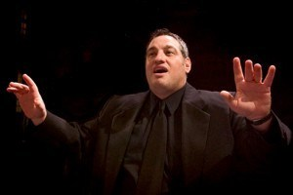
Dr. Jim Henry, Co-Director of the FOUR TIME International Barbershop Harmony Society Chorus Champions, Ambassadors of Harmony, St. Louis, MO.

Slide 18


Slide 19
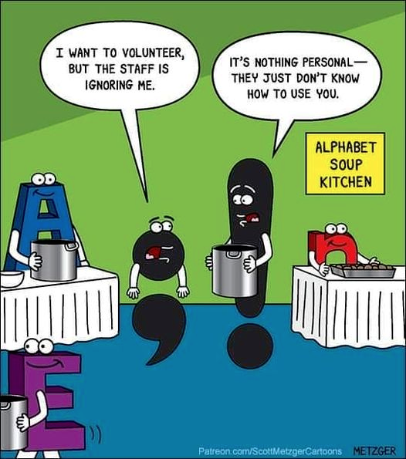

Slide 20


Slide 21
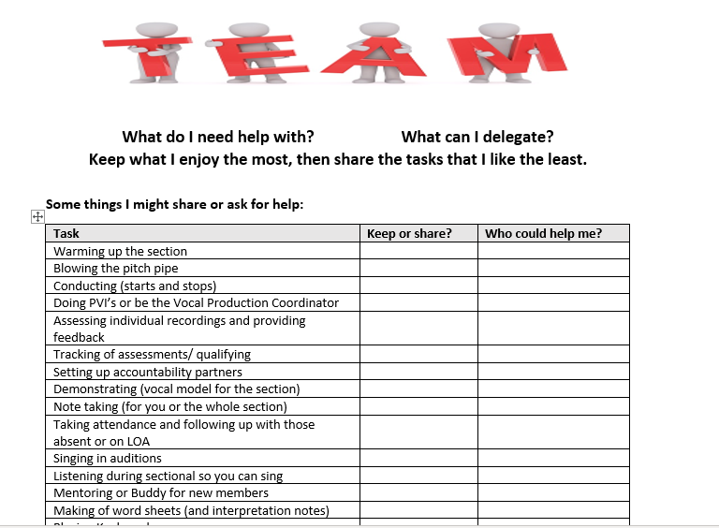

Slide 22

This Photo by Unknown Author is licensed under CC BY-SA-NC

Slide 23


Slide 24


Slide 25

This Photo by Unknown Author is licensed under CC BY-SA-NC

Slide 26


Slide 27
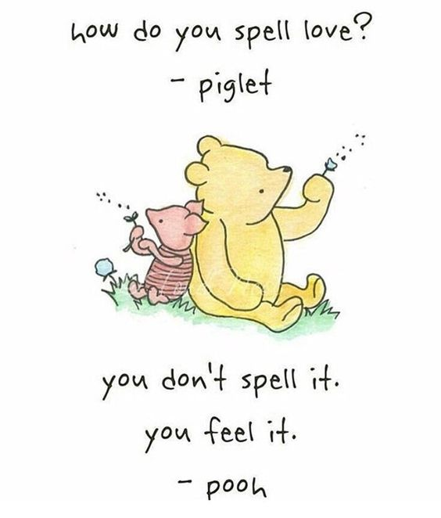

Slide 28

This Photo by Unknown Author is licensed under CC BY-NC

Slide 29


Slide 30

This Photo by Unknown Author is licensed under CC BY-NC

Slide 31


Slide 32


Slide 33
Know Your Part/Know You're Part
Right from the start, you must know your part.
When I first came to chorus, when I first heard the song
wasn't sure I could do it, or if I'd belong.
I was welcomed with words that seemed timely and smart:
"If you want to fit in, know your part."
Know your part; know each measure, every verse and refrain.
Know your part, when you're silent and when to sustain.
Know your part, breath together or sneak out alone.
Know your part, learn your place in the cone.
So I struggled and studied. I mastered the song!
I sang tall. I sang forward. I learned right from wrong.
I returned to rehearsal and said at the start
that I confidently know my part!

Slide 34
How they smiled when they told me, I'd misunderstood,
that it wasn't a question of just sounding good.
The advice they had offered was meant to impart,
when you're here, to be clear, know you're part, remember:
You are part of a family. You're part of a team.
Know you're a part of a group that will say what we mean.
Know you're part of a future built from the past.
Know you're part of a song that will last!
Hold onto that song, safe and warm in your heart.
You will know, though years may go,
you are part; know you are part!
Author: Unknown

Slide 35
Objectives:
Clarify the role between the Section Leader and the Director, as well as the role between the Section Leader and her singers
Team Building begins with Trust and Mutual Respect. We’ll review the components of these two important pillars of Team Building.
The section needs a positive, safe environment to flourish and grow. Here’s how the section leader can nourish this type of environment for singing and learning.
Identify what responsibilities can/ should be delegated to your team members.

Slide 36
Nancy Kurth
nkurth@msn.com

