Slide 1


Slide 2

Add new skills
Redefine the role
Re-frame the value

Slide 3
Build an analogy…
Compare two things
Unique pairing
Nudge you “outside the box”

Slide 4

A good section leader is like a stapler because…

Slide 5

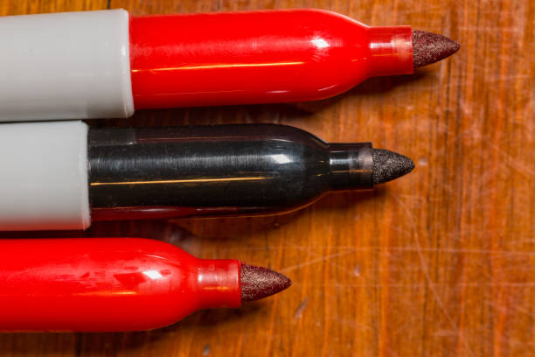
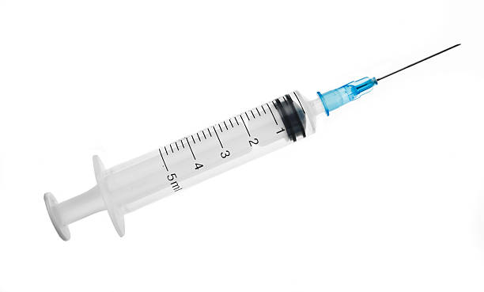

A good section leader is like…
because…

